Slide 1


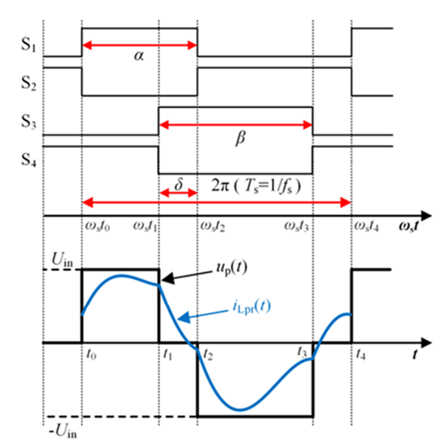
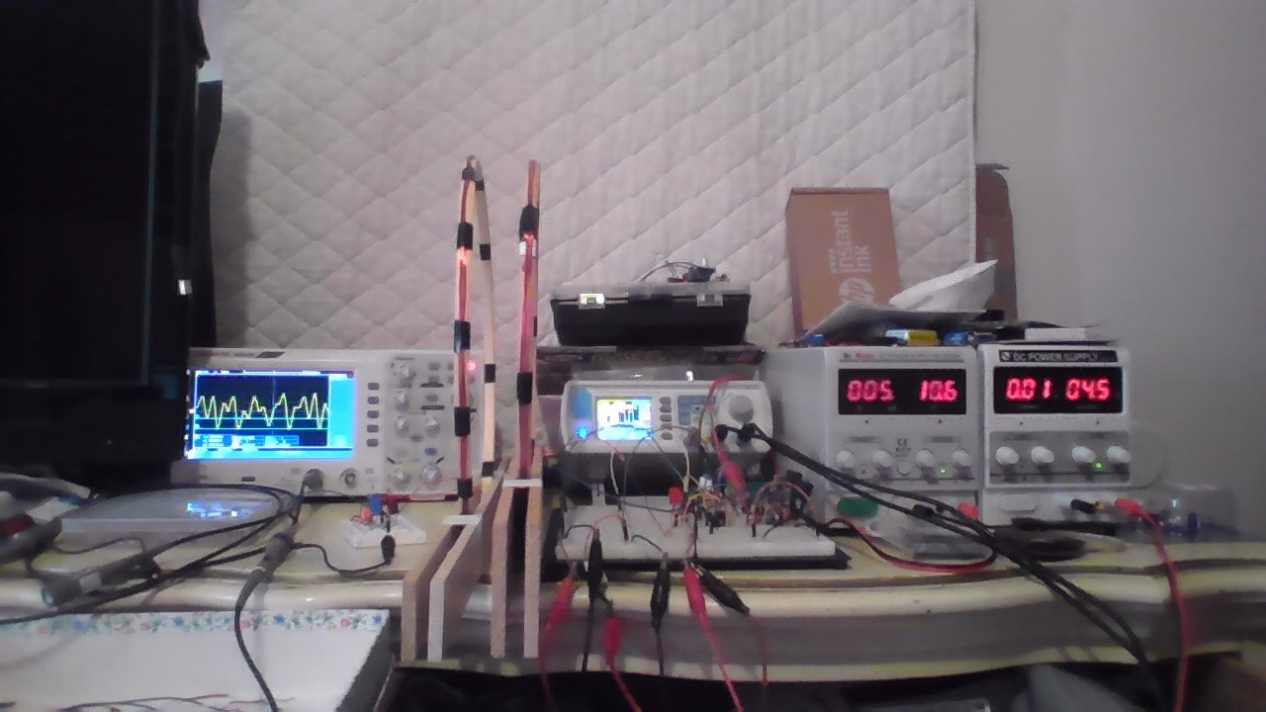
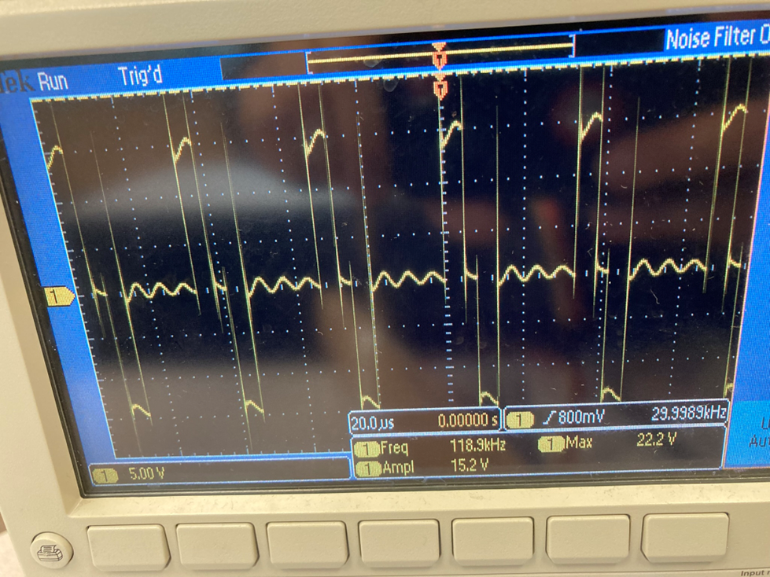
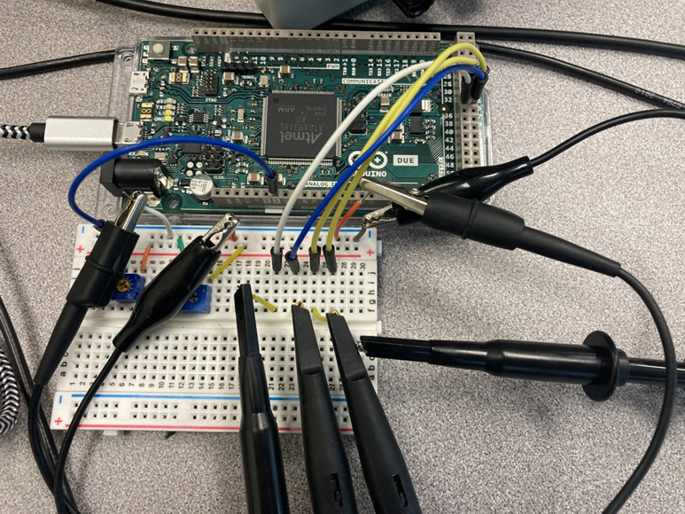
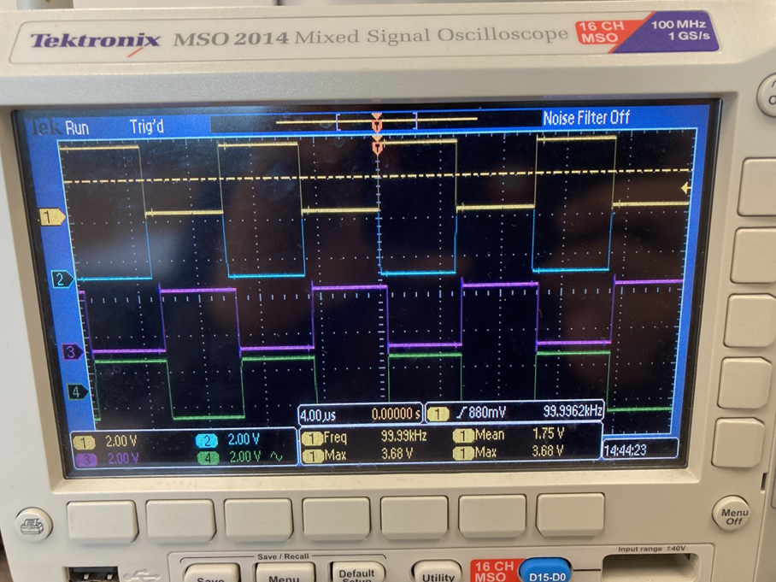
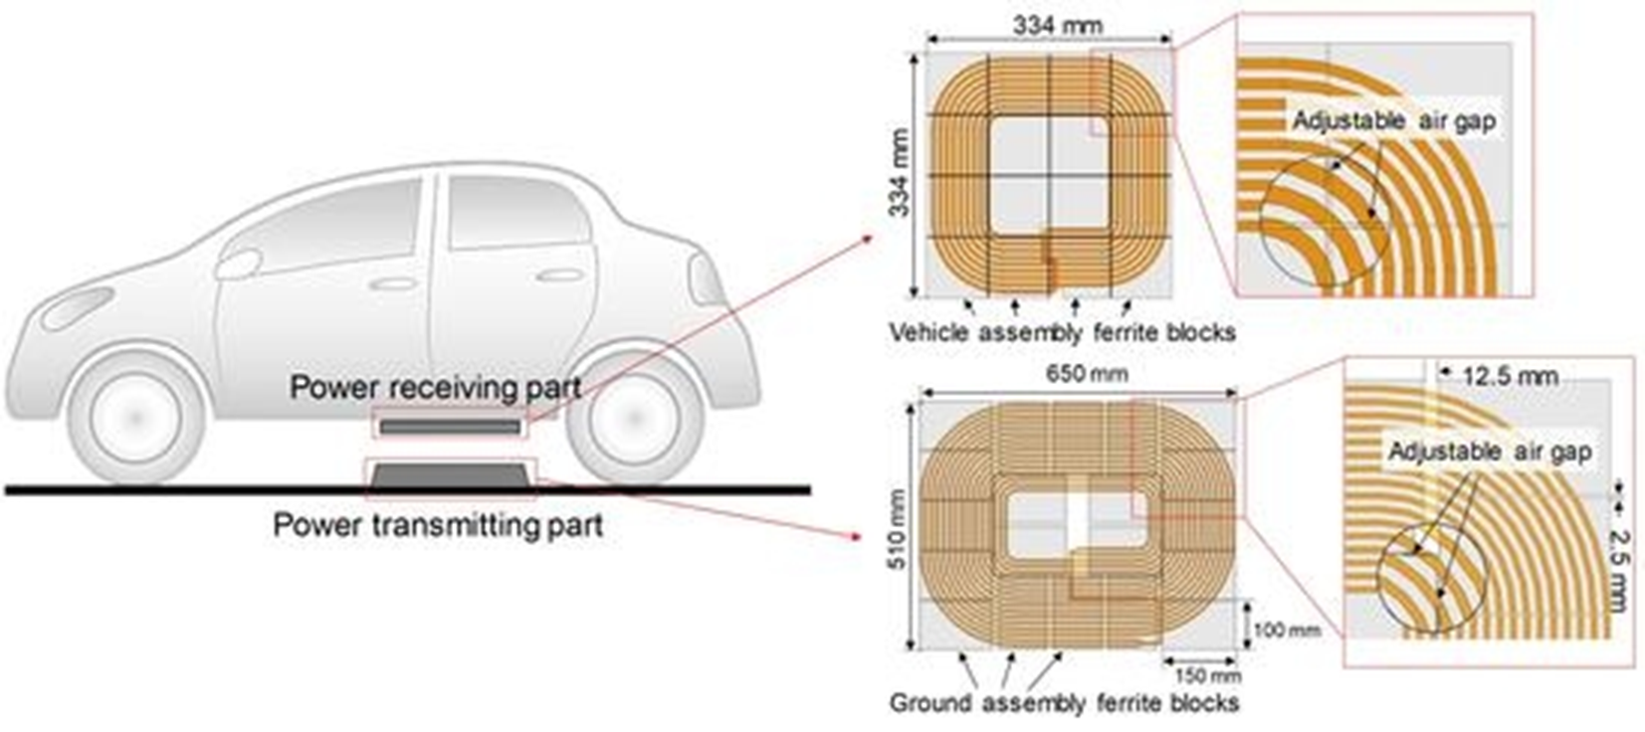
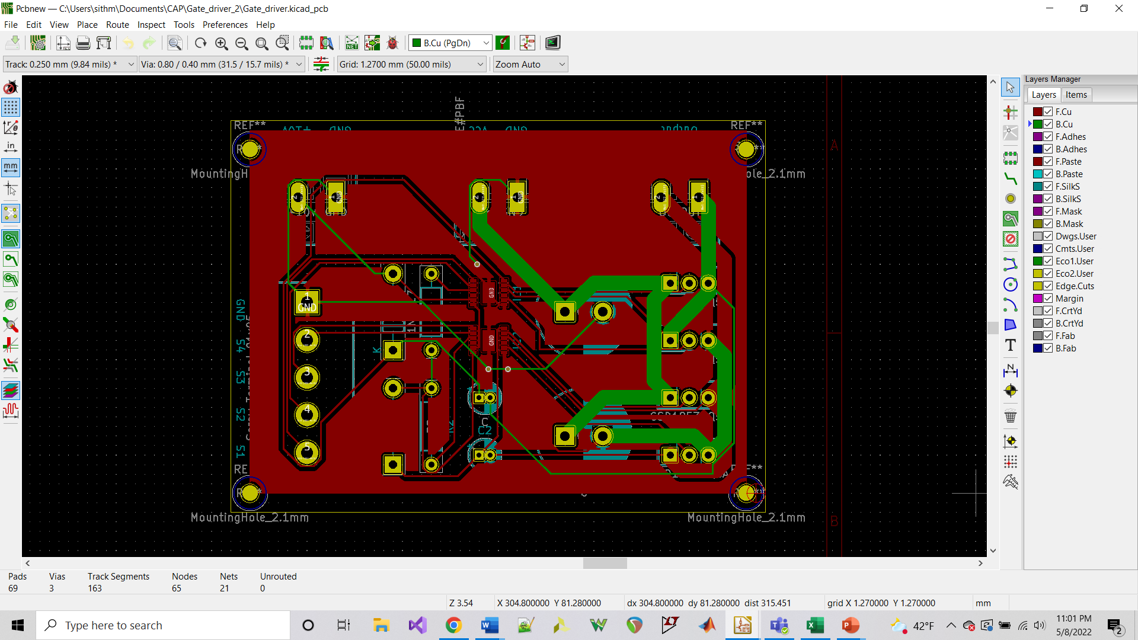
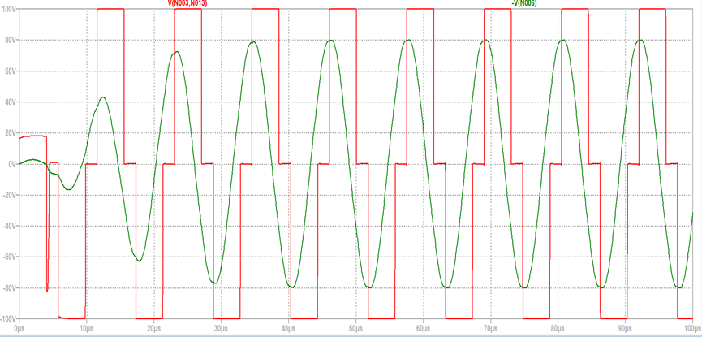
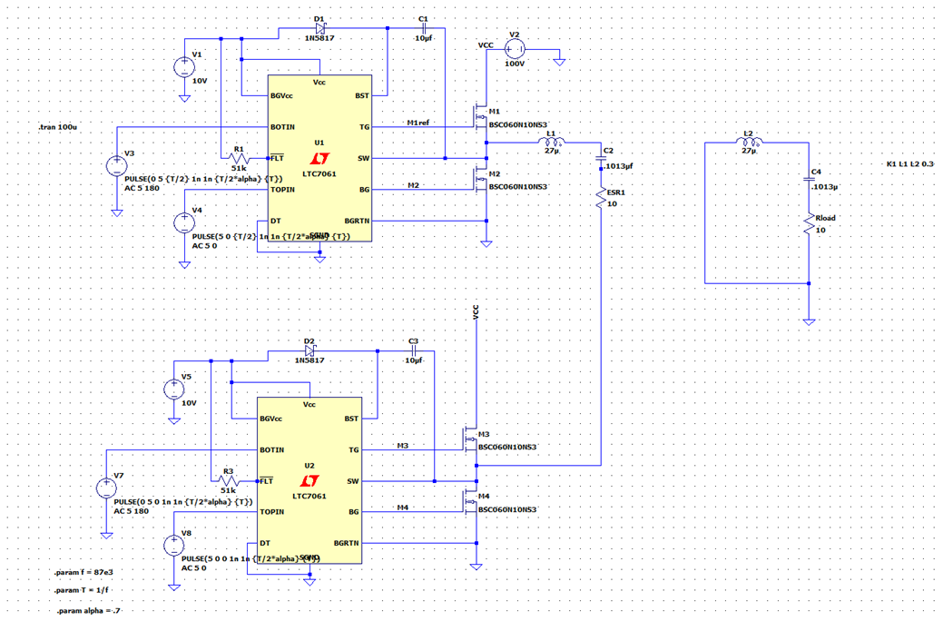
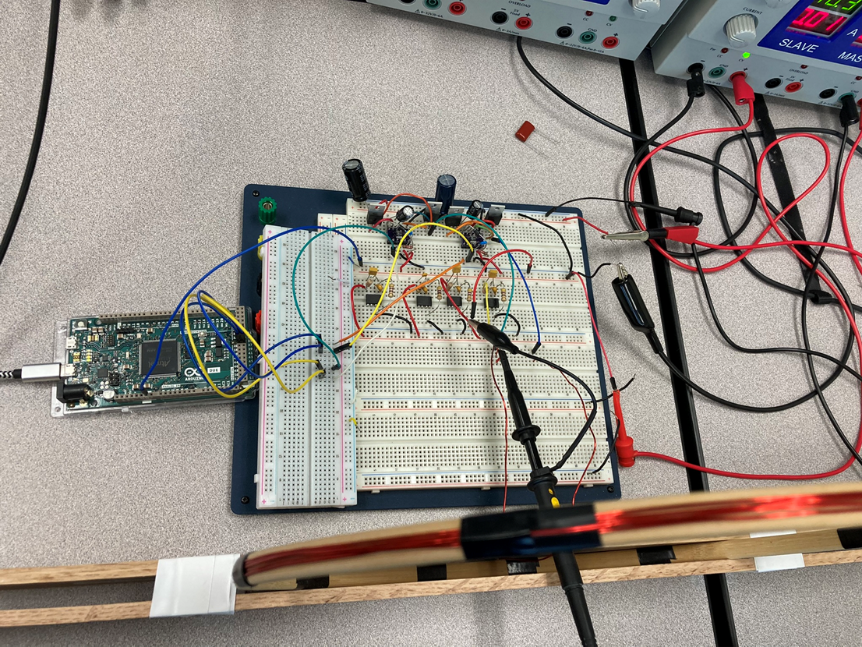
Open-Source Test Platform for Wireless Power Transfer Research at Oregon Institute of Technology Max Perez, Craig Sanchez, Jeremy Mahan
EE Capstone Project
May 2022
Introduction
Method
Results
Wireless charging is rapidly gaining popularity as a convenient charging solution for many applications like consumer electronics. With the use of electric vehicles on the rise, the idea of using wireless charging for electric vehicles is becoming a reality. The need for more research on the topic creates an opportunity for students at Oregon Tech to be on the forefront of developing this technology. Though, for this research to take place, a test platform is needed.
Fig 2. Theoretical Timing diagram for complementary signals. [2]
Fig 6. Final Project Test
Fig 8. Oscilloscope Measurement Output signal from the Transmitter Coils
Fig 3. Microcontroller PWM signals
Fig 1 . Tx and Rx coils. [1]
Objectives
The expected outcomes is to design and implement a prototype that can be used to support wireless power transfer research at Oregon Tech. The platform will consist of:
A microcontroller to supply 4 PWM signals.
A gate driver circuit to receive the PWM signals.
A full-bridge inverter with 4 power MOSFETs (driven by the gate drivers) capable of handling the voltage requirements.
Two inducting coils for wireless power transfer.
A simple DC converter circuit for charging purposes.
Fig 7. Gate Driver PCB design using kiCad.
Fig 9. LTspice simulation output.
Conclusions
Fig 4. LTspice Simulation of Gate Driver
Overall, the design was a success. Both the Ltspice simulation and the breadboard circuit work as expected. Using the microcontroller, we have control over the frequency and duty cycle of the signal that is sent to the gate drivers to control the MOSFET switching. As the PCB circuit was taken directly from the simulation schematic, which is the same as the breadboard circuit, we expect that when the PCB arrives, and the components are soldered into place it should perform as well as the breadboard circuit. There is also the option to add to this PCB design, such as the opto-isolator circuit if needed, or choosing different connector types for either the output coil, the power supply connections, or the input connections from the microcontroller. As it stands right now, we have a working design that is waiting for the PCB to be checked and verified. If the PCB does not perform as expected, we know that that is where the problem is since our breadboard circuit works as expected. If the PCB needs to be modified, it should not be too difficult to accomplish. Regardless, this should give us a steppingstone to work from to further develop the wireless power transfer platform.
Acknowledgements
The project is advised by our capstone advisor, Dr. Aaron Scher, he is a professor at Oregon Tech and has experience working with Oregon tech undergraduates. Aaron has published a wireless power research paper and worked as a visiting researcher in 2020 at Oak Ridge National Laboratory in EV (electric vehicles) wireless charging and supported the team through the project.
References
Fig 5. Full bridge inverter breadboard design.
[1] Texas Instruments, “Power Stage Reference Design for <100-VIN DC/DC Converterss,” Design Guide: TIDA-050022, May 2019 [Revised June 2019].
[2] S. Ahmet Sis, H. Akca. "Maximizing the efficiency of wireless power transfer systems with an optimal duty cycle operation". AEU-International Journal of Electronics and Communications, Volume 116, 2020, 153081, ISSN 1434-8411, https://doi.org/10.1016/j.aeue.2020.153081

